Slide 1

12th Grade
School Counseling Presentation
What you need to know to start planning for your greatest possible future
*Presentation will be made available at paxonguidance.weebly.com and the Paxon School Counseling Teams page

Slide 2
Who Is My School Counselor?
Paxon School for Advanced Studies Counseling Team
Dionne Clayton claytond@duvalschools.org | AP Students in Grades 9 &10: A - H AP Students in Grades 11&12: A - G
Linda Bajalia Bajalial@duvalschools.org | AP Students in Grades 9 &10: I - T AP Students in Grades 11&12: H - O
Krystal Culpepper apolonk@duvalschools.org | All IB Students in Grades 11 & 12
Michelle Mullen mullenm@duvalschools.org | AP Students in Grades 9 &10: U - Z AP Students in Grades 11&12: P – Z All IB Prep Students in Grades 9 & 10

Slide 3
How Do I Contact My School Counselor?
To meet with Paxon’s Counselors:
Students:
  Send an email to your assigned counselor to schedule a virtual or phone conference.
  Visit the Paxon School Counseling Team. Counselors are live and available on the General channel for questions Monday-Friday at the following times:
    8:00-8:10am
    11:15-11:25am
    12:50-1:00pm
    2:55-3:10pm
Parents: Send an email to your student’s assigned counselor to schedule a virtual or phone conference.

Slide 4
Paxon Counseling Office Staff
Support Staff
Ms. Bouie bouies@duvalschools.org (904)693-7583 | Scheduling parent/teacher conferences FOCUS portal information Hard copies of transcripts Attendance clerk
Ms. Bennett bennettb2@duvalschools.org (904)693-7583 | Student Records Enrollment Electronic Transcript Requests

Slide 5
Attendance & Reporting of Absences
Upcoming absences should be reported to classroom teachers and the Attendance Clerk (Ms. Bouie) by email
  You may copy your counselor on emails sent
  Students are responsible for work missed during absences

Slide 6
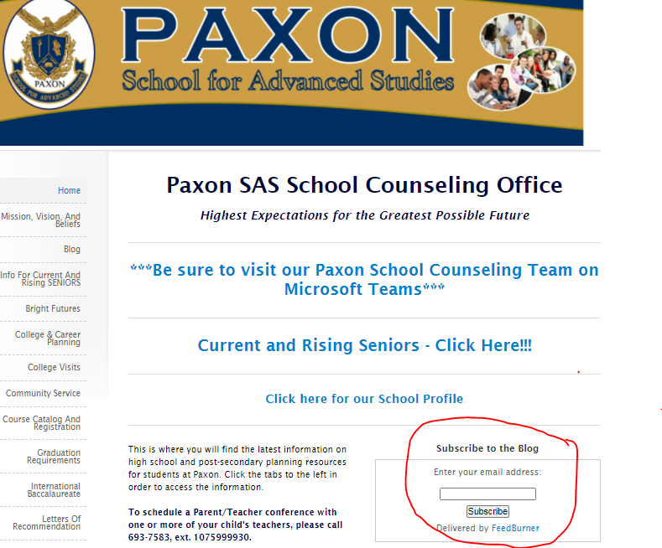
www.paxonguidance.weebly.com
Calendar of events
College and Career Planning
Scholarship and testing info

Slide 7

Graduation Requirements
Links available at paxonguidance.weebly.com

Slide 8
Graduation Requirements and the Scholar Diploma Designation
  English: 4 credits
  Math: 4 credits (Algebra I, Geometry, Algebra 2, and 1 more equally rigorous math)
  Science: 3 credits (Biology and 2 additional equally rigorous science classes)
  Social Science: 3 credits (1 World History, 1 American History, ½ American Gov’t, ½ Economics)
  World Language: 2 credits (must be in the same language)
  Visual/Performing Art: 1 credit
  HOPE: 1 credit
  Additional Electives: 6 credits
  Paxon AP Course Requirement: Minimum of 7 AP courses
  Passing score on the FSA: grade 10 Reading
  State required EOCs (Algebra I, Geometry, Biology, US History)
  Cumulative unweighted 2.0 GPA
  1 Online Course (via FLVS or Duval Flex)

Slide 9

Report Card Grades & FLVS
If a student receives an ‘F’ for a 1st semester course.....
Make an appointment to speak with your assigned counselor
Sign up for the course on FLVS immediately
Course must be completed by April 2, 2021.

Slide 10
Graduation Requirements MUST Be Met to Participate in Senior Activities
This includes:
  Community service hours (at least 75)
  Virtual course requirement
  Missing course requirements
  **These must all be completed by April 2, 2021 to be eligible for Grad Bash and Senior Week activities!!

Slide 11
A Message from our Senior Class Sponsor
Paxon’s Senior Class Sponsors will be communicating information regarding dues and Senior Week activities to the Class of 2021 and their families soon!
Initial questions and/or concerns can be directed to Mr. Smith at ‘smithk5@duvalschools.org.’

Slide 12



Resources at Paxon
Learning Lab is scheduled to begin on Sept. 21, 2020.
Available on Teams M, T, Th, F @ 7:30am; during both lunches; after school (except Friday) on
Classroom Teacher Tutoring (schedule on website)
School and Counseling Department websites and Teams
Follow Paxon on Facebook, Twitter, and Instagram

Slide 13
ACT & SAT
ACT: Register at www.act.org
  ACT Academy – Free, personalized test prep
SAT: Register at www.collegeboard.com
  Khan Academy – Free personalized test prep
  Seniors will take the SAT for free on October 14, 2020 at Paxon.
    DVHR students - Please be sure to check your student email if you plan on taking the SAT at Paxon on Oct. 14th. There is a survey you need to submit ASAP!
  The University of North Florida offers free virtual ACT/SAT test prep sessions for DCPS students. Students do need to register for the event, and it is on a first-come, first served basis. In order to register, students will need to visit the following website:
    https://www.unf.edu/welcomecenter/DCPS_Test_Prep.aspx
Don’t delay completing college applications because of test scores!!!

Slide 14
ACT or SAT Waiver Qualifications
The student....
Is enrolled in or eligible to receive free/reduced lunch
Family income falls within the Income Eligibility Guidelines set by the USDA
Family receives public assistance
Lives in federally subsidized public housing, a foster home, or is homeless
Is a ward of the state or an orphan
*Contact your Counselor for waivers if you qualify. You may also receive college application fee waivers. *
Don’t delay completing college applications because of test scores!!!

Slide 15
Bright Futures and
Community Service
Links available at paxonguidance.weebly.com

Slide 16
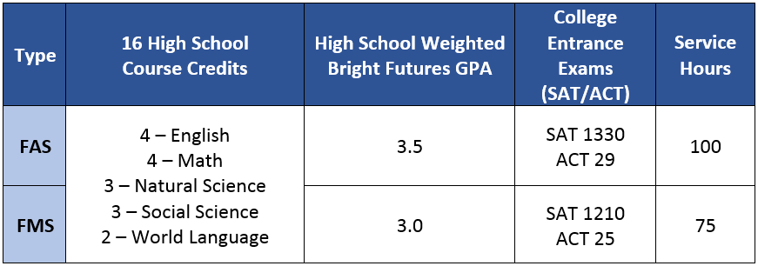
Bright Futures Requirements
Students may take the SAT and ACT exams until June 2021 for
Bright Futures qualifying scores.

Slide 17
Bright Futures GPA Calculation
The student’s best grades in each subject area will be used
  4 credits of English
  4 credits of Math
  3 credits of Science
  3 credits of Social Studies
  2 credits of Foreign Language
FFAA & FAFSA
applications open
on October 1, 2020
**Students may use up to 2 additional credits from courses in the academic areas listed above as well as AP or IB fine arts courses to raise the GPA.
**Keep in mind that course grades are weighted for Bright Futures GPA calculation BUT are given different weighting than
DCPS GPA calculation.

Slide 18
Community Service
Paxon SAS requires that all students perform a minimum of 75 hours of community service.
Students cannot be paid for the service, and it must be performed at a non-profit agency. Be very careful with doing service at/through religious institutions – not every thing counts.
Community Service should be meaningful.
To eliminate headaches later, students must complete the pre-approval form BEFORE starting the service.

Slide 19
Community Service
For each different activity that is completed, 3 forms must be turned in to the counseling office:
  Community Service Pre-Approval Form
  Community Service Log Form
  Student Reflections Form
Forms are available on Paxon’s website: psas.duvalschools.org under the guidance tab and on the Paxon guidance website at paxonguidance.weebly.com
All completed community service documentation is due to the school counseling office no later than April 2, 2021 (Seniors)

Slide 20
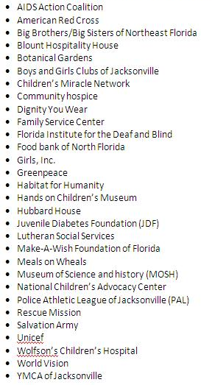
Places for Community Service
For more examples and links,
please visit the Paxon school
counseling website at
www.paxonguidance.weebly.com
*Must be a non-profit organization

Slide 21

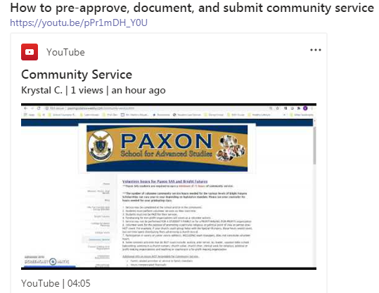
Community Service
Check out
on the Paxon School Counseling Team site for an instructional video

Slide 22
college and career planning
Links available at paxonguidance.weebly.com

Slide 23
College Planning
Be sure to visit colleges and universities BEFORE you make a final decision.
Colleges visit Paxon virtually (via Teams/Zoom) to speak to students during both lunch periods.
  Schedule posted outside of the school counseling office, on the Paxon school counseling website, linked on the Paxon school website, and said during announcements
  Students must have teacher permission to miss class to attend the visit if it is scheduled during a lunch when they have class or during class time.

Slide 24

Virtual College Fairs
  600+ Colleges and Universities will offer Zoom sessions
  Visit www.virtualcollegefairs.org to register for free
    ~Sept. 13: 12-8 p.m. ET
    ~Oct. 12: 1-9 p.m. ET
    ~Oct. 18: 12-8 p.m. ET
    ~Nov. 8: 2-10 p.m. ET

Slide 25
College Applications
Now is the time to apply!!!
Do not wait for the “perfect” test score or GPA.
Be aware of deadlines (application, financial aid,
test scores, etc.)
Make sure you are familiar with how to access
the application.
  Ex. Common Application, Coalition
  Application, or via individual college
  websites

Slide 26
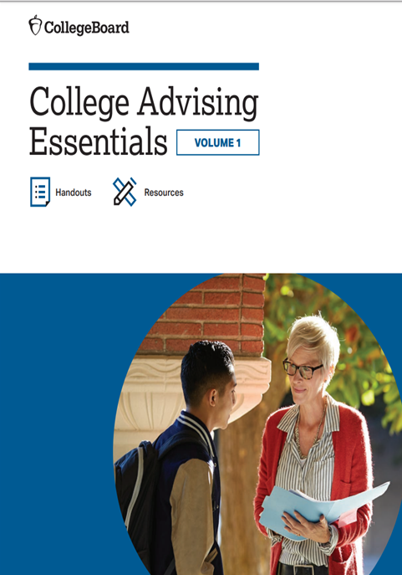
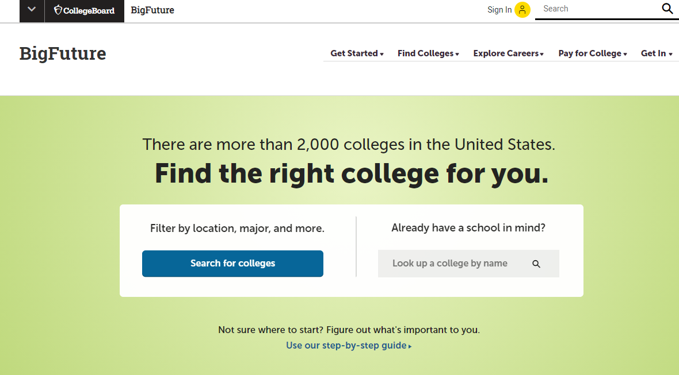
Where do I start?
A resource from the CollegeBoard
www.bigfuture.org
Many other search engines are linked on our website
http://paxonguidance.weebly.com/college--career-planning.html
Link available on the Paxon School Counseling webpage. Click on the link Parent Info tab.

Slide 27
The State University System of Florida –
A Quick Look at How to Apply
School Name | Where is the Application Available?
 | Institutional App | Common App | Coalition App
FAMU* | X
FAU* | X | X
FGCU | X | X
FIU* | X
FL Poly* | X | X
FSU* | X | X | X
New College* |  | X
UCF** | X | X
UF* |  | X | X
UNF* |  | X
USF | X | X | X
UWF | X | X
*Denotes use of the SSAR on the application
**Denotes use of SPARK on the application

Slide 28
Letters of Recommendation and
Transcript Requests
Links available at paxonguidance.weebly.com

Slide 29
Requesting a Letter of Recommendation
Complete the Paxon Letter of Recommendation Information Form on the Paxon School Counseling website.
  Please be thorough and descriptive in your responses!
Ask your counselor at least 2 weeks prior to when you need your completed letter.
  If 2 weeks notice is not given, you may not be able to receive a completed letter

Slide 30
Transcript Requests
Information and forms for requesting transcripts are on our Paxon Guidance website. They are electronically sent to our data clerks when you complete them.
Two different types of transcript requests:
  In-state, public colleges/universities (sent electronically)
  Out-of-state or private colleges/universities & scholarships (hard copy given to student...specify if it needs to be official vs. unofficial)
You may request up to 5 hard copy official transcripts
  Over 5 copies: Student will be given 1 transcript and student must bring copies back to the counseling office to be made official
Submit your transcript requests at least 2 weeks prior to when it is needed
  If 2 weeks notice is not given, you may not be able to receive your transcript

Slide 31



Transcript Requests
If applying through any of these sites, your counselor can upload your transcript electronically...
Make sure to inform your counselor if you need your transcript uploaded.

Slide 32
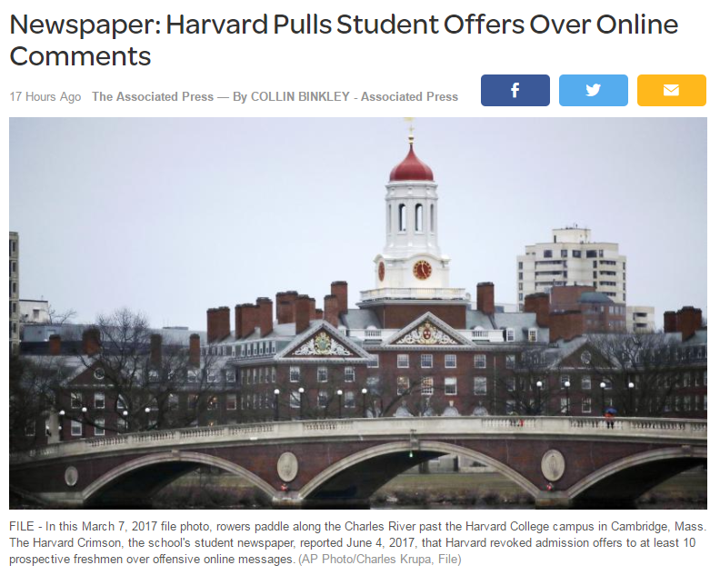
Be Careful on Social Media...

Slide 33

Questions, Comments, Concerns
Contact Your Counselor!
Dionne Clayton claytond@duvalschools.org | AP Students in Grades 11&12: A - G
Linda Bajalia Bajalial@duvalschools.org | AP Students in Grades 11&12: H - O
Michelle Mullen mullenm@duvalschools.org | AP Students in Grades 11&12: P – Z

